Slide 1


BANNARI AMMAN
INSTITUTE OF TECHNOLOGY
(An Autonomous Institution, Affiliated to Anna University, Approved by AICTE, Accredited by NAAC with ‘A+’ Grade)
IOT HACKATHON
Team Name:AI-AURA
Problem Statement: Motion Detection Sensor
Team Details: (Sudharsan P, Mathan M, Prasanna M, Harish A)

Slide 2
Problem statement:
A motion detection sensor system identifies movement using built I device.This project utilizes the DeviceMotion API in the mobile devices to detect motion and provide realtime feedback.Its helpful for the old people who can’t see and hear.It was Easily Controled in the mobile,Laptop and this was fully worked by only remote and IR Blaster.

Slide 3
Abstract:
Motion detection systems are widely used in security and smart applications for Detecting the people. This project aims to develop a web-based motion detection system using the DeviceMotion API (Appilcation program interface) available in modern smartphones. The expected outcome is a cost-effective and it is easy to bulit.

Slide 4
Proposed Solution:
Built-in Sensors – Use accelerometer data from mobile devices to detect movement.
Hardware Dependency – No need for external motion sensors, To making it cost-effective.
Spam - Implement thresholds to reduce false detections and improve accuracy.

Slide 5
Methodology
Requirement - the need for a software-based motion detection system
Design - Plan event handling for motion detection using accelerometer data.
Implementation - Capture acceleration data (X, Y, Z values) using the DeviceMotion API.
BIT V-PRAYUKTI'25

Slide 6
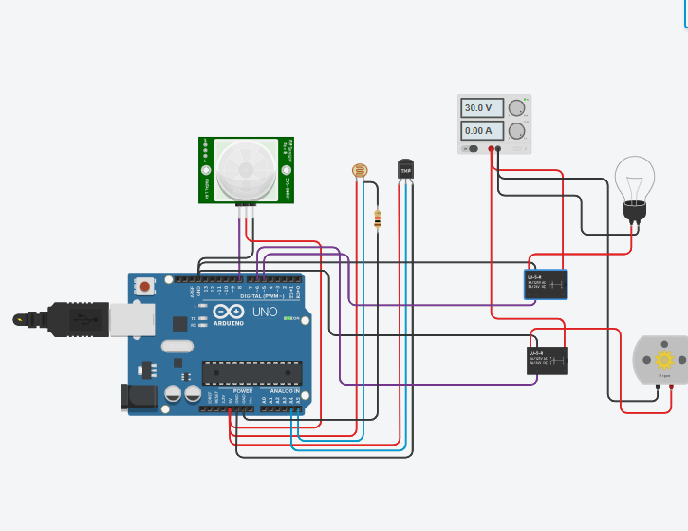
Approach:
(Explain the working in a flow/block diagram)

Slide 7
Components required during the course of Hackathon:
DC Motor
Resistor
Reley SPDT
Arduino
PIR Sensor
Photo Resistor
.

Slide 8
Elevator pitch video (1 minute)
Share the public link

